Slide 2
Unit 3: Continuous System (8 hrs)
3.1 Introduction To Continuous System
3.2 Representation Of Continuous System Using Differential Equation
3.3 Linear And Nonlinear Differential Equations And Its Examples
3.4 Analog Computer (Components And Examples)
3.5 Digital Analog Simulators
3.6 Hybrid Computers
3.7 CSSLs, CSMP III
3.7.1 Structured Statement
3.7.2 Data Statements
3.7.3 Control Statements
3.8 Feedback System With Example
3.9 Interactive System

Slide 3
Feedback System
Feedback systems operate on a closed-loop structure, where the results from past actions influence future actions of the system.
This means that feedback systems are affected by their previous behavior.
Feedback occurs when the output from a past event impacts the occurrence of the same event in the present or future.
When an event is part of a cause-and-effect chain that forms a circuit or loop, it is said to "feed back" into itself.

Slide 4
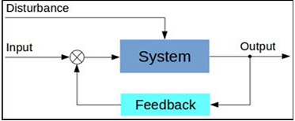
Feedback System

Slide 5
Feedback System
Example:
A home heating system with a thermostat is a simple example of a feedback system. The furnace heats the room, and the output, room temperature, is measured. If the temperature is below or above the thermostat setting, the furnace will turn on or off, providing feedback from the output to the input. The system has two states: the furnace is either on or off.
A feedback system for blinds would automatically open them at sunrise and adjust them during the day to block direct sunlight.

Slide 6
Interactive System
Interactive systems are computer systems characterized by significant amounts of interaction between humans and the computer.
An interactive system is a type of system designed to engage in a continuous exchange of information between a user and a computer, machine, or model.
These systems respond to user inputs in real time or near-real time, allowing users to interact, manipulate, or explore the system dynamically.

Slide 7
Interactive System
All computer systems involving a high degree of human-computer interaction are interactive systems.
Examples include Editors, CAD-CAM (Computer Aided Design-Computer Aided Manufacturer) systems, and Data Entry Systems.
Games, VR and simulations are interactive systems.
Web browsers and Integrated Development Environments (IDEs) are also examples of very complex interactive systems.

Slide 8
Features of Interactive System
Feature | Description
User Input | Users can give commands, enter data, or manipulate components.
Real-time Feedback | The system reacts quickly to user actions, often immediately.
Interface | Involves a UI/UX that facilitates communication between user and machine (keyboard, mouse, touchscreen, etc.).
Two-way Communication | Unlike passive systems, interaction flows both ways.
Adaptability | May adapt based on user behavior or inputs.

Slide 9
Predator-Prey Model
The Predator-Prey Model is a classic example of a continuous system simulation used in ecology to describe the dynamic interaction between two species: a predator and its prey.
It is also called the parasite-host model.
An environment consists of two populations, i.e., predator and prey.
It is also a mathematical model.
The prey is passive, but the predator depends on the prey for their source of food.

Slide 10
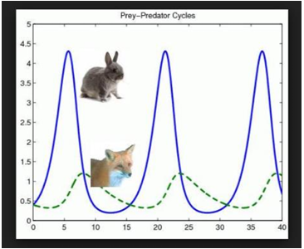
Predator-Prey Model
Prey (x) increase exponentially if predators aren't present.
Predator population (y) decreases without prey.
Predator-prey interaction (xy) affects both growth and decline.

Slide 11
Predator-Prey Model
Oscillating Populations:
Prey grows → predators grow (more food) → prey decreases → predators decrease → prey grows again.
The system cycles through booms and crashes in both populations.

Slide 12
Predator-Prey Model
Let, x(t) = number of prey population at time t.
y(t) = number of predator population at time t.
rx(t) = rate of growth of prey for some positive ‘r’, where r = natural birth and natural death rate.

Slide 13
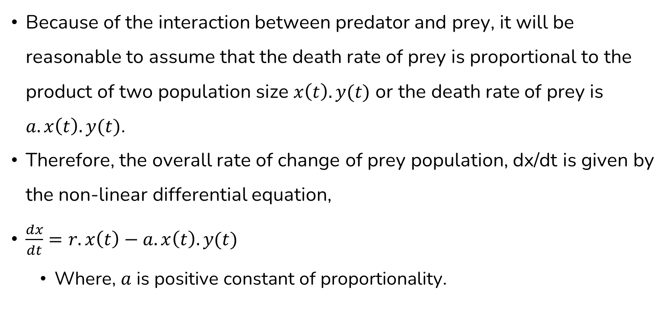
Predator-Prey Model
Because of the interaction between predator and prey, it will be reasonable to assume that the death rate of prey is proportional to the product of two population size $x\left(t\right).y(t)$ or the death rate of prey is $a.x\left(t\right).y(t)$.
Therefore, the overall rate of change of prey population, dx/dt is given by the non-linear differential equation,
$\frac{dx}{dt}=r. x\left(t\right)−a.x\left(t\right).y(t)$
Where, $a$ is positive constant of proportionality.

Slide 14
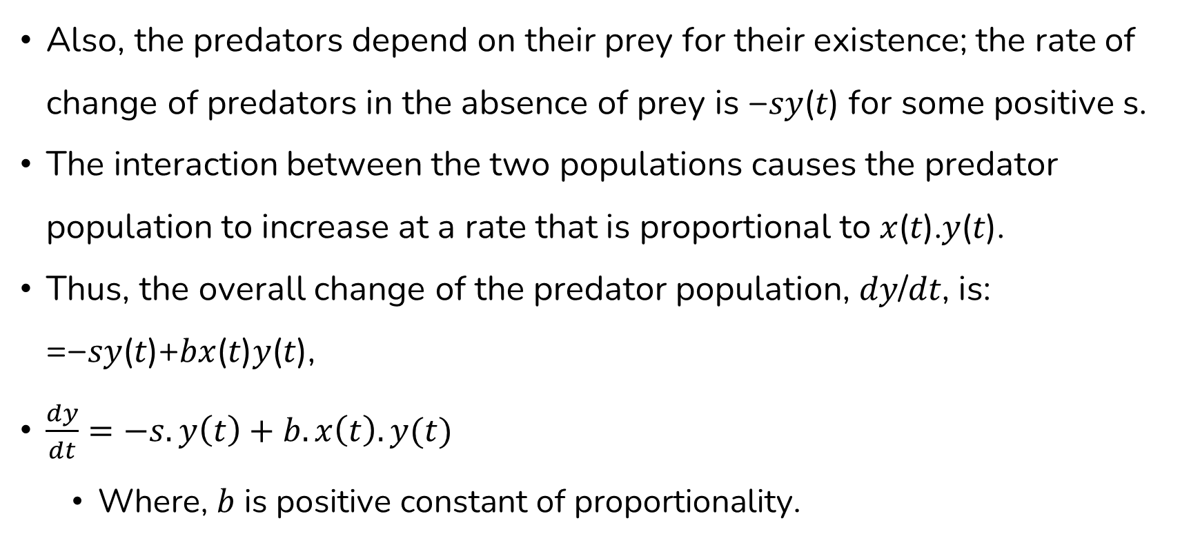
Predator-Prey Model
Also, the predators depend on their prey for their existence; the rate of change of predators in the absence of prey is −𝑠𝑦(𝑡) for some positive s.
The interaction between the two populations causes the predator population to increase at a rate that is proportional to 𝑥(𝑡).𝑦(𝑡).
Thus, the overall change of the predator population, 𝑑𝑦/𝑑𝑡, is: =−𝑠𝑦(𝑡)+𝑏𝑥(𝑡)𝑦(𝑡),
$\frac{dy}{dt}=−s. y\left(t\right)+b.x\left(t\right).y(t)$
Where, $b$ is positive constant of proportionality.

Slide 15
Predator-Prey Model
As the predator population increases, the prey population decreases.
This causes the decrease in the rate of increased predator, which eventually results in decrease in a number of predators.
These, in turn, cause the number of prey to increase.

Slide 16
Assignment
The Pure Pursuit Model
A Serial Chase Problem

Slide 17
End of Lecture 10

Slide 18
Discrete System Simulation

